Slide 1


Example-Driven Query Intent Discovery:
Abductive Reasoning using Semantic Similarity
Anna Fariha
Alexandra Meliou
College of Information and Computer Sciences
University of Massachusetts Amherst
Notes:
Good afternoon. I am Anna Fariha from University of Massachusetts, Amherst. This work is done by me and Prof. Alexandra Meliou. Today, I am going to talk about SQuID, a system that lets you query a relational database without writing any SQL query.

Slide 2





Are databases accessible to non-experts?
Who are our most valuable customers?
Notes:
We live in a time where data is highly available.
All sorts of people want to use this data. But, the problem is, people who don’t have expertise in data systems don’t have a simple way to access and use these data.
About 65% of the structured data resides in relational databases. To access these data, SQL expertise is a must, which a lot of these people simply don’t have.

Slide 3
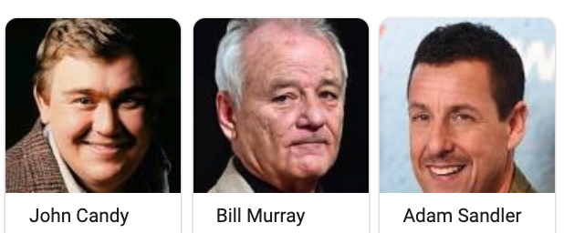

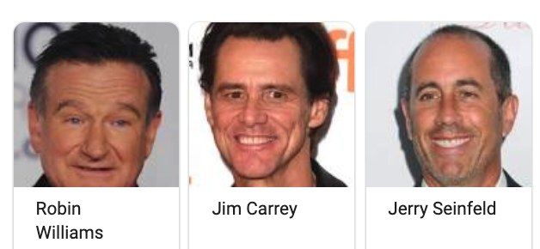
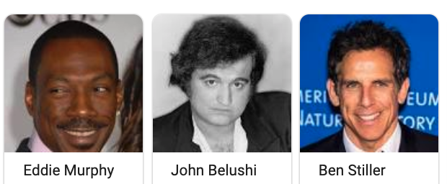
Alice wants to find all Funny Actors from the IMDb database.
Notes:
Let’s take for example the IMDb database. IMDb has all information about movies, actors, their relationships like who was cast in which movie, and so on.
Now suppose that Alice has IMDb loaded in a relational database, and she wants to find all funny actors.
Let’s see the steps Alice will have to go through for that.

Slide 4
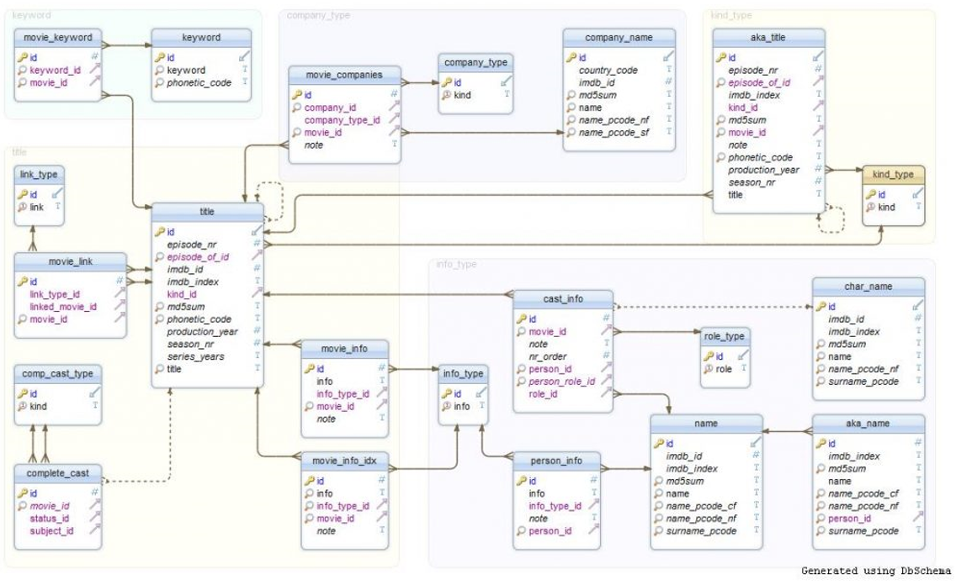

Challenge 1: understanding the schema
Notes:
The first step is understanding the schema. This is what the IMDb schema looks like.
And getting a good understanding of the schema is very challenging for Alice.

Slide 5
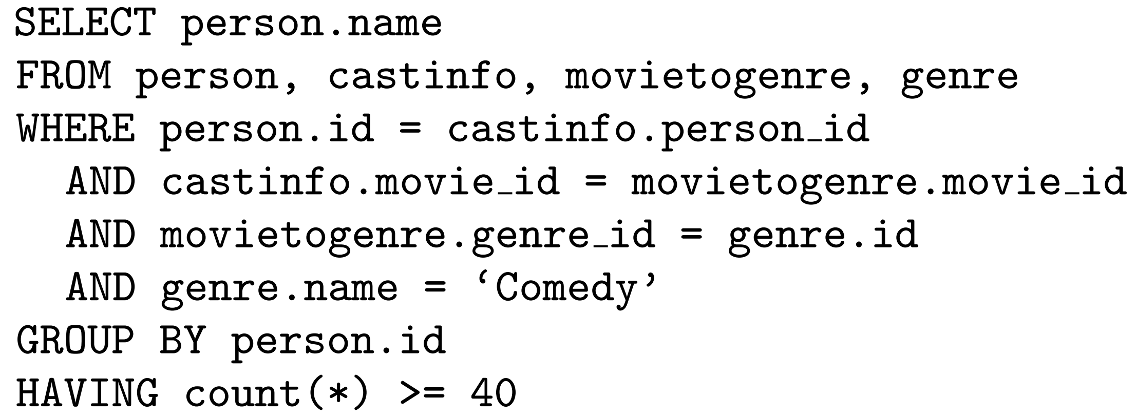
Challenge 2: SQL expertise
Notes:
Next, Alice has to learn a query language, like SQL, and write a query to express her intent. This is what the query would look like.
Again, this is a very challenging for Alice, who has no programming background.
What we really need, is a way so that Alice can easily express what she wants, and the system takes care of this complex technical aspects.

Slide 6
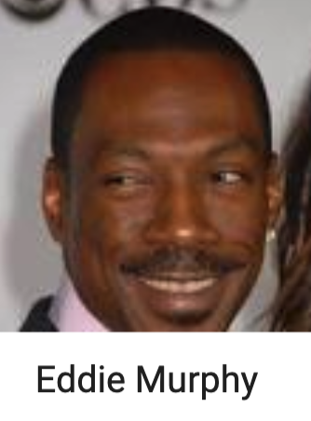
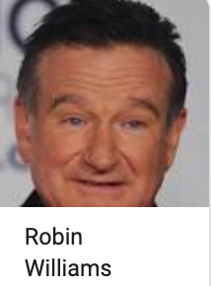
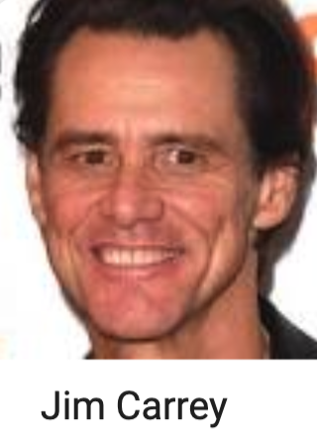
Query by example
QBE
Notes:
There are alternative Query by Example systems, that bypasses the complexity of writing SQL query, and instead, works just with examples.
In a QBE systems, you just give few examples. So for funny actors, we can give Eddie Murphy, Robin Williams and Jim Carrey, as examples.
And the system is supposed to figure out your query intent,
and return all the funny actors.

Slide 7
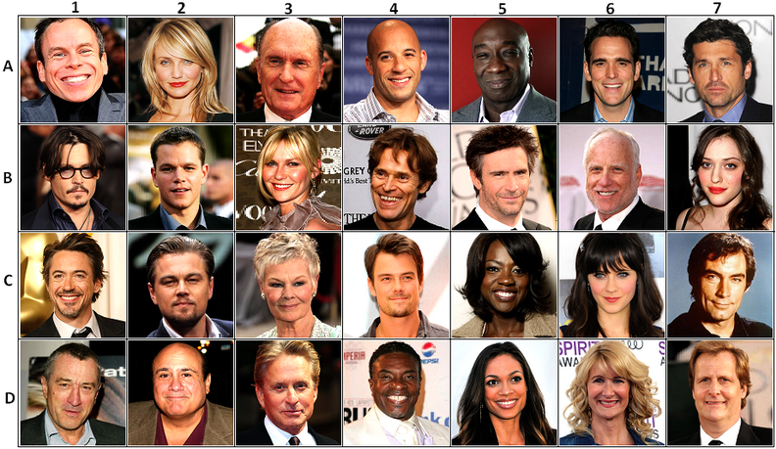
Expectation vs reality
All actors
Notes:
But this is not what happens in reality. If we give these example funny actors to a traditional QBE system,
this is what we get. A list of all actors in the data.
The reason is that, these systems only look at the type of the example values and detects intent that is too general.
As human, we can see that, Alice likely intends to find out all funny actors. So how do we see the intent here?

Slide 8

Humans use context
Notes:
As human, we see context, like what is similar across the examples.

Slide 9



Discovering semantic similarity
Comedy
Comedy
Comedy
Comedy
Comedy
Comedy
There is no “funny” attribute in the data
Comedy
Comedy
Comedy
Comedy
Comedy
Comedy
Comedy
Comedy
Comedy
Comedy
Comedy
Comedy
Notes:
So how can we help QBE system to detect the context of funny actor? Unfortunately, there is no funny attribute in the data.
But this information exists in the data! If we take a closer look within the database and look at the types of movies these actors appear in,
we will find this. Jim Carrey appeared in more than 40 Comedy movies, and so did Robin Williams and Eddie Murphy. This is a semantic similarity.

Slide 10
Query by example
Knowledge Graph
QBE
limited
context
QRE
learning
active learning
Query
Reverse
Engineering
requires all output
overfits
too many examples
too much interaction
Notes:
How do existing approaches deal with context? Traditional QBE methods actually don’t,
QBE on Knowledge Graphs handles context in very limited way.
Query Reverse Engineering works on the very restrictive closed-world assumption, and requires the entire query output as examples.
Learning methods require way too many examples.
Finally, active learning methods require a lot of user interactions.

Slide 11
SQuID
Semantic similarity-aware
Query Intent Discovery
Notes:
In this talk, I will talk to you about SQuID – which is an acronym for semantic similarity-aware query intent discovery.

Slide 12
What’s coming
Modeling Semantic Context
Query Intent Discovery
Real-time Performance
Evaluation
Notes:
In the rest of this talk, I would explain to you how SQuID models semantic context, how it discovers the user’s intent based on the semantic context, how it does so efficiently, and some evaluation results.

Slide 13
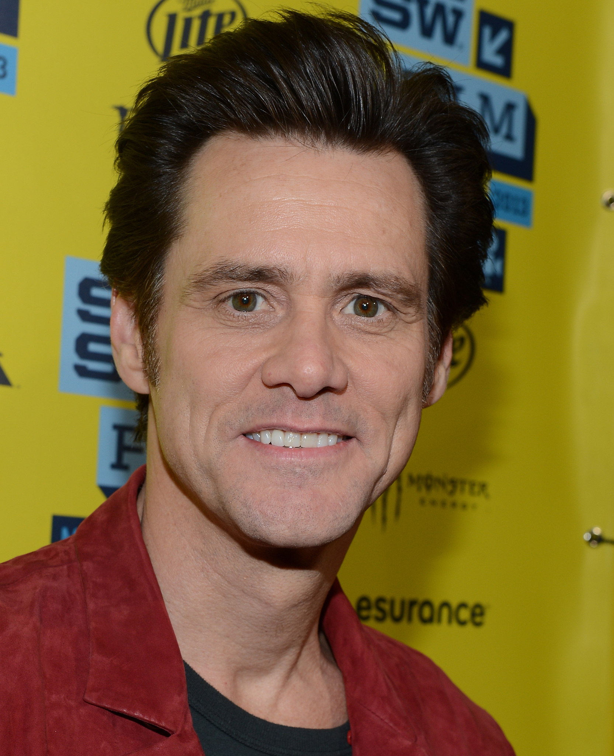
Semantic context: basic
Modeling Semantic Context
Query Intent Discovery
Real-time Performance
Evaluation
Directly affiliated with an entity.
birth year
1962
gender
Male
person
height
6’ 2’’
age
57
Notes:
We categorize semantic context in two types. The basic semantic properties are directly associated with an entity, like birth year or gender of a person.
For example, Jim carry is male, and it is his basic property.

Slide 14
Semantic context: derived
Modeling Semantic Context
Query Intent Discovery
Real-time Performance
Evaluation
Aggregate over a basic property of an associated entity.
  number of comedy movies an actor appeared in.
40 Comedy movies
genre
10 Drama movies
person
movie
language
67 English movies
Notes:
The derived semantic properties come from aggregating over basic properties of affiliated entities.
like the number movies of a particular genre is a derived derived property for an actor.
For example, derived properties for Jim Carrey is that he appeared in 40 Comedies, 10 Dramas, and so on.

Slide 15

Filters
Modeling Semantic Context
Query Intent Discovery
Real-time Performance
Evaluation
Encode semantic context.
SELECT
person
FROM
people
WHERE
color = orange
Notes:
So how do we encode semantic contexts in SQL? We use selection predicates.
In SQuID, we use the term Filters which are technically combination of selection predicates.
But for the purpose of this talk, you can assume that filters and selection predicates are same.

Slide 16
Intended or co-incidental?
Modeling Semantic Context
Query Intent Discovery
Real-time Performance
Evaluation
Male
Born in North America
Appeared in 80+ Hollywood movies
Appeared in 40+ comedy movies
Appeared in 20+ drama movies
Height above 5 feet
Born after 1940
…
Notes:
So far, I highlighted that all these people are funny actors, and I inferred this context from the fact that they appear in mostly comedy movies.
But these people are similar in other ways too. They are all male, they are all born in North America, and so on. Are all of these similarities intended by Alice?
How do we figure this out? Unfortunately there is no way to be sure.
Due to this uncertainty, in SQuID, we apply an inference mechanism called abduction.

Slide 17
Abduction
Modeling Semantic Context
Query Intent Discovery
Real-time Performance
Evaluation
Most likely explanation of an observation.
Most likely query given the examples.
Maximum likelihood estimation is abduction!
Notes:
So what is Abduction? It is an inference mechanism that derives the most likely explanation of an observation.
In query intent discovery, the observation is the examples, and their semantic context. Our goal is to find the the most likely query intent, given the examples.
This is in contrast with Deduction which would have guaranteed that the inferred query is the one in user's mind. But deduction is not applicable in query by example setting.

Slide 18
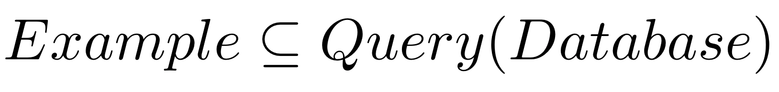
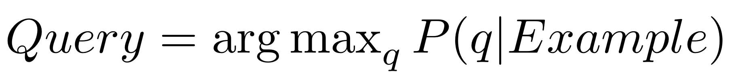
Problem definition
Modeling Semantic Context
Query Intent Discovery
Real-time Performance
Evaluation
Query intent discovery: given a Database and Example, find Query such that:
Notes:
So here is our problem definition: Given some examples, our goal is to find the query that satisfies these two criteria.
One: the examples should be part of the query result, and
Two: the query should maximize the posterior probability of being the intended one, given the examples.

Slide 19
Probabilistic abduction model
Modeling Semantic Context
Query Intent Discovery
Real-time Performance
Evaluation
semantic context posterior
query prior
query posterior
semantic context prior
Notes:
Our goal is to compute the Query posterior, the probability of a query being the intended one, given the examples.
Starting with Bayes formula, and since context is function of the examples, we can compute the query posterior using these three components…
query prior, which is the probability of that query being the intended one, without any observation.
semantic context prior, which estimates how likely is it to observe that context in a random example set.
and semantic context posterior, the probability that a semantic context is observed, after seeing the query.
In the next few slides, I will explain how we estimate these three terms.

Slide 20
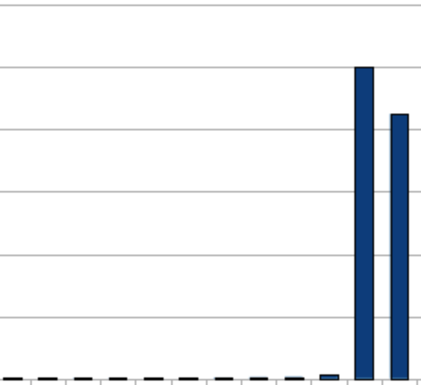



Modeling Semantic Context
Query Intent Discovery
Real-time Performance
Evaluation
Domain selectivity
Association strength
Outlier
SELECT * FROM p
WHERE 25 <= age <= 30
25 30
age
0 5 90 100
SELECT * FROM p
WHERE 5 <= age <= 90
Notes:
So how do we estimate query prior?
A query is mostly about the set of filters it applies. If we can estimate the filter priors, we can combine them to estimate query prior.
To estimate filter prior, we use three intuitions.
Our first intuition is domain selectivity. Out of these two queries, the one on top is more specific than the bottom one. Our assumption is that filter that puts stricter constraints is more likely.
There are two other intuitions involving derived semantic properties, but I don’t have time to go over these in this talk. Please refer to our paper for more details.

Slide 21
Modeling Semantic Context
Query Intent Discovery
Real-time Performance
Evaluation
Data selectivity
 | country
… | USA
… | USA
… | USA
… | USA
… | USA
… | CAN
… | USA
… | CAN
… | USA
… | USA
USA: 80%
CAN: 20%
Notes:
We move on to estimate the second term, semantic context prior.
For this, the data can give us the answer. If we look at the data distribution inside the relations, we will see that the USA is more frequent than Canada.
So, prior to applying any filter, observing the context USA is more likely than Canada.

Slide 22
Modeling Semantic Context
Query Intent Discovery
Real-time Performance
Evaluation
Context
Predicate in Query
 | country
… | USA
… | USA
… | USA
… | USA
… | USA
… | CAN
… | USA
… | CAN
… | USA
… | USA
 | country
… | USA
… | USA
 | country
… | USA
 | country
… | USA
… | USA
… | USA
 | country
… | USA
… | USA
… | USA
P(USA| country = USA)
= 1
P(USA | No Filter)
= 0.8
P(USA | No Filter)
= 0.8 * 0.8
= 0.64
P(USA | No Filter)
= 0.8 * 0.8 * 0.8
= 0.51
Notes:
Now I will explain the last term of this equation: context posterior, which is the probability of observing a context, given the query.
If you put the actual predicate in the query, then you know that you will definitely observe the context in the query output.
So now we want to figure out the probability that we will see the context, if we don’t put the predicate in the query.
Suppose that we see only one example with the context USA. So now the probability of observing the context, is just the proportion of the data that has this context.
What about now? With two examples, probability is a product of observing the two examples individually, assuming independence. So it will be 64%.
The key point here is, that the more examples we see, the less likely is it that the context is just by chance.

Slide 23

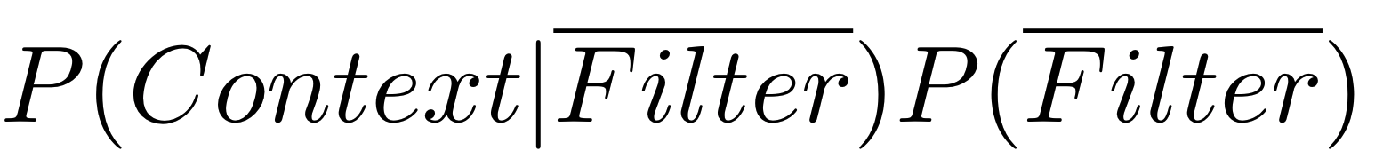
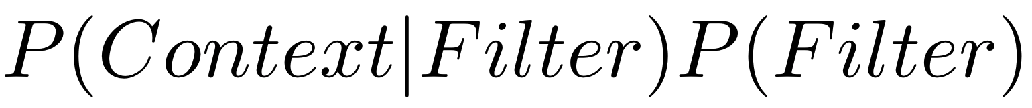
SQuID algorithm
Modeling Semantic Context
Query Intent Discovery
Real-time Performance
Evaluation
Filters: to pick or drop?
Without filter
With filter
Notes:
Now I will talk about the algorithm to infer the most likely query.
As we show in the paper, a simple exact algorithm can find the most likely query intent, without trying all possible queries. The algorithm boils down to a simple principle.
For each filter, if this probability is higher with the filter, then we pick the filter, and drop otherwise.

Slide 24

Real-time performance
Modeling Semantic Context
Query Intent Discovery
Real-time
Evaluation
Notes:
Everything I have talked so far, depends on the contexts observed in the examples. But how do we discover the semantic contexts of the examples on the fly?

Slide 25
Abduction-ready database
Modeling Semantic Context
Query Intent Discovery
Real-time
Evaluation
Notes:
The key component of SQuID is an abduction-ready database. It is an augmentation of the original database with derived relations, semantic property statistics and so on.
The abduction ready database is precomputed in an offline module.
The online module makes use of it for real time query intent discovery.

Slide 26
How well does SQuID do in practice?
Notes:
So how does SQuID do in practice? I will now talk about our evaluation results.

Slide 27
Modeling Semantic Context
Query Intent Discovery
Real-time Performance
Evaluation
How efficient is SQuID for large datasets and many examples?
Does SQuID infer the right query?
Can alternative techniques be effective in intent discovery?
  Query Reverse Engineering (TALOS, 2014)
  Positive and Unlabeled Learning (Elkan et al., 2008)
Query run-time comparison [In the paper]
Case studies [In the paper]
Notes:
The goal of our experiments was to find answer of these questions.
First, how efficient is SQuID for large datasets and many examples?
Second, Does SQuID infer the right query?
And third, how does SQuID compare against other alternative techniques, such as query reverse engineering, and machine learning.
We have more results in our paper, but I would skip those in today’s talk.

Slide 28



Datasets
Modeling Semantic Context
Query Intent Discovery
Real-time Performance
Evaluation
[In the paper]
633 MB
15 relations
person: 6M rows
movies: 1M rows
castinfo: 14M rows
5 benchmark queries
20 benchmark queries
16 benchmark queries
Notes:
We used three datasets in our experiments, but in this talk, I will be presenting experiments on the IMDb datasets. IMDb dataset has a complex schema with 15 relations about movies, actors, cast information, etc. We designed 16 benchmark queries on this dataset, with varying complexity with up to 8 joins, 7 selections, and varying result sizes.

Slide 29

Experiment Settings
Modeling Semantic Context
Query Intent Discovery
Real-time Performance
Evaluation
Inferred Query
Result
Sample
SQuID Result
Example
Benchmark Query
Compare
Ground Truth
Notes:
I will now talk to you about our experimental settings involving the benchmark queries. For this experiment,
we took a benchmark query,
executed it,
and considered the query result as the ground truth.
Then we took a small random sample from the ground truth and used that as example.
We gave it to SQuID.
SQuID returned an inferred query. We executed that query,
And found SQuID result.
Then we compared SQuID result against the ground truth in terms of precision, recall, and F-score.

Slide 30
How does SQuID perform with large datasets or many examples?
Modeling Semantic Context
Query Intent Discovery
Real-time Performance
Evaluation
Abduction time is practical
Logarithmic
in DB size
Linear in example size
Notes:
We varied the number of examples and tried IMDb datasets with three different sizes for the scalability experiment.
We found that, SQuID’s abduction time is linear in number of examples,
and logarithmic in database size.
Also, the inference time is practical. For about 5 to 10 examples, it only takes few seconds on IMDb.

Slide 31
SQuID works with few examples
Modeling Semantic Context
Query Intent Discovery
Real-time Performance
Evaluation
Indian actors who acted in
at least 15 Hollywood movies
Notes:
So how accurate SQuID’s inference is?
So here is the overall result over 16 benchmark queries. In most cases, the F-Score rises pretty quickly with very few examples.
Let’s focus on a representative query, with a complex task to find all Indian actors who appeared in at least 15 Hollywood movies. SQuID was able to quickly catch up with the true intent with only about 10 examples.
There are some cases where SQuID does not do as well. But we found that rare and only happens when the query is too complex and falls outside SQuID’s search space.

Slide 32
Query Reverse Engineering
Modeling Semantic Context
Query Intent Discovery
Real-time Performance
Evaluation
Input
Output
QRE
TALOS
Reverse Engineered Query
Exact match required
Notes:
An approach similar to query by example is query reverse engineering. Query reverse engineering is similar to query by example as it takes query results as input and produces query as output.
However, they require the examples to match exactly the query output having a closed world assumption. In contrast, our setting is more permissive, OPEN WORLD SETTING. We only require that the query output contains the examples.
We compared SQuID with TALOS, a query reverse engineering system.

Slide 33
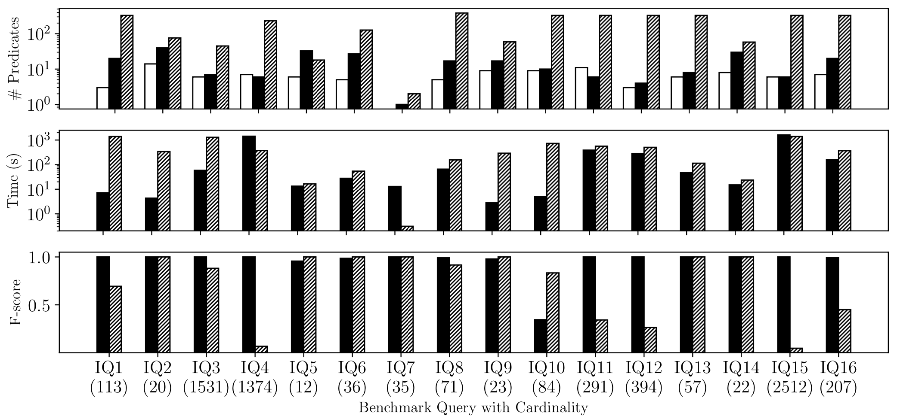
SQuID outperforms
Query Reverse Engineering (TALOS)
Modeling Semantic Context
Query Intent Discovery
Real-time Performance
Evaluation
Log scale
Log scale
Notes:
Both SQuID and TALOS were given the entire output of the 16 benchmark queries. In general SQuID is better than TALOS in terms of F-Score, and also the inference is usually faster.
But what I want to focus on, is the quality of the inferred queries – how similar is the inferred query compared to the actual query.
For most of the queries, TALOS produced much larger queries than the actual ones with 100s of predicates. Note that, the y-axis is in log scale.

Slide 34
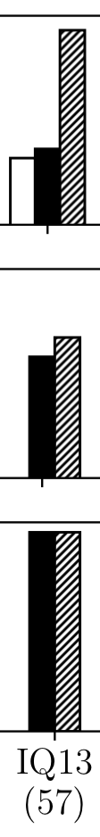
SQuID outperforms
Query Reverse Engineering (TALOS)
Modeling Semantic Context
Query Intent Discovery
Real-time Performance
Evaluation
SELECT
DISTINCT movie.title
FROM
movie, production, company, movietogenre, genre
WHERE
movie.production_year >= 1984 AND
movie.production_year <= 2021 AND movie.country = USA AND
genre.name = 'Animation' AND company.name = 'Pixar' AND
movie.id = movietogenre.movie_id AND
genre.id = movietogenre.genre_id AND
movie.id = movietoproduction.movie_id AND
company.id = movietoproduction.company_id
Original Query
SELECT
DISTINCT movie.title
FROM
movie, production, company, movietogenre, genre
WHERE
movie.id = production.movie_id AND
production.company_id = company.id AND
company.name LIKE '%Pixar%' AND
movie.id = movietogenre.movie_id AND
movietogenre.genre_id = genre.id AND
genre.name = 'Animation';
TALOS Query
SELECT
distinct title
FROM
movie
WHERE
  ((movie.title='Inside Out' OR movie.title='Lifted' OR movie.title='Lou' OR movie.title='For the Birds' OR movie.title='Brave' OR movie.title='Coco')) OR ((movie.title<>'Inside Out' AND movie.title<>'Lifted' AND movie.title<>'Lou' AND movie.title<>'For the Birds' AND movie.title<>'Brave' AND movie.title<>'Coco') AND (movie.title='A Bug"s Life' OR movie.title='André and Wally B.' OR movie.title='Boundin"' OR movie.title='Burn-E' OR movie.title='Cars 2' OR movie.title='Cars 3')) OR ((movie.title<>'Inside Out' AND movie.title<>'Lifted' AND movie.title<>'Lou' AND movie.title<>'For the Birds' AND movie.title<>'Brave' AND movie.title<>'Coco') AND (movie.title<>'A Bug"s Life' AND movie.title<>'André and Wally B.' AND movie.title<>'Boundin"' AND movie.title<>'Burn-E' AND movie.title<>'Cars 2' AND movie.title<>'Cars 3') AND (movie.title='Dante"s Lunch: A Short Tail' OR movie.title='Finding Dory' OR movie.title='Finding Nemo' OR movie.title='Geri"s Game' OR movie.title='Hawaiian Vacation' OR movie.title='It"s Tough to Be a Bug')) OR ((movie.title<>'Inside Out' AND movie.title<>'Lifted' AND movie.title<>'Lou' AND movie.title<>'For the Birds' AND movie.title<>'Brave' AND movie.title<>'Coco') AND (movie.title<>'A Bug"s Life' AND movie.title<>'André and Wally B.' AND movie.title<>'Boundin"' AND movie.title<>'Burn-E' AND movie.title<>'Cars 2' AND movie.title<>'Cars 3') AND (movie.title<>'Dante"s Lunch: A Short Tail' AND movie.title<>'Finding Dory' AND movie.title<>'Finding Nemo' AND movie.title<>'Geri"s Game' AND movie.title<>'Hawaiian Vacation' AND movie.title<>'It"s Tough to Be a Bug') AND (movie.title='Knick Knack' OR movie.title='Luxo Jr.' OR movie.title='Luxo Jr. in "Surprise" and "Light & Heavy"' OR movie.title='Luxo Jr. in "Up and Down"' OR movie.title='Monsters University' OR movie.title='Monsters, Inc.')) OR ((movie.title<>'Inside Out' AND movie.title<>'Lifted' AND movie.title<>'Lou' AND movie.title<>'For the Birds' AND movie.title<>'Brave' AND movie.title<>'Coco') AND (movie.title<>'A Bug"s Life' AND movie.title<>'André and Wally B.' AND movie.title<>'Boundin"' AND movie.title<>'Burn-E' AND movie.title<>'Cars 2' AND movie.title<>'Cars 3') AND (movie.title<>'Dante"s Lunch: A Short Tail' AND movie.title<>'Finding Dory' AND movie.title<>'Finding Nemo' AND movie.title<>'Geri"s Game' AND movie.title<>'Hawaiian Vacation' AND movie.title<>'It"s Tough to Be a Bug') AND (movie.title<>'Knick Knack' AND movie.title<>'Luxo Jr.' AND movie.title<>'Luxo Jr. in "Surprise" and "Light & Heavy"' AND movie.title<>'Luxo Jr. in "Up and Down"' AND movie.title<>'Monsters University' AND movie.title<>'Monsters, Inc.') AND (movie.title='Party Central' OR movie.title='Partysaurus Rex' OR movie.title='Red"s Dream' OR movie.title='Riley"s First Date?' OR movie.title='Sanjay"s Super Team' OR movie.title='The Good Dinosaur')) OR ((movie.title<>'Inside Out' AND movie.title<>'Lifted' AND movie.title<>'Lou' AND movie.title<>'For the Birds' AND movie.title<>'Brave' AND movie.title<>'Coco') AND (movie.title<>'A Bug"s Life' AND movie.title<>'André and Wally B.' AND movie.title<>'Boundin"' AND movie.title<>'Burn-E' AND movie.title<>'Cars 2' AND movie.title<>'Cars 3') AND (movie.title<>'Dante"s Lunch: A Short Tail' AND movie.title<>'Finding Dory' AND movie.title<>'Finding Nemo' AND movie.title<>'Geri"s Game' AND movie.title<>'Hawaiian Vacation' AND movie.title<>'It"s Tough to Be a Bug') AND (movie.title<>'Knick Knack' AND movie.title<>'Luxo Jr.' AND movie.title<>'Luxo Jr. in "Surprise" and "Light & Heavy"' AND movie.title<>'Luxo Jr. in "Up and Down"' AND movie.title<>'Monsters University' AND movie.title<>'Monsters, Inc.') AND (movie.title<>'Party Central' AND movie.title<>'Partysaurus Rex' AND movie.title<>'Red"s Dream' AND movie.title<>'Riley"s First Date?' AND movie.title<>'Sanjay"s Super Team' AND movie.title<>'The Good Dinosaur') AND (movie.title='The Incredibles' OR movie.title='The Incredibles 2' OR movie.title='Tin Toy' OR movie.title='Tokyo Mater' OR movie.title='Toy Story' OR movie.title='Toy Story 2')) OR ((movie.title<>'Inside Out' AND movie.title<>'Lifted' AND movie.title<>'Lou' AND movie.title<>'For the Birds' AND movie.title<>'Brave' AND movie.title<>'Coco') AND (movie.title<>'A Bug"s Life' AND movie.title<>'André and Wally B.' AND movie.title<>'Boundin"' AND movie.title<>'Burn-E' AND movie.title<>'Cars 2' AND movie.title<>'Cars 3') AND (movie.title<>'Dante"s Lunch: A Short Tail' AND movie.title<>'Finding Dory' AND movie.title<>'Finding Nemo' AND movie.title<>'Geri"s Game' AND movie.title<>'Hawaiian Vacation' AND movie.title<>'It"s Tough to Be a Bug') AND (movie.title<>'Knick Knack' AND movie.title<>'Luxo Jr.' AND movie.title<>'Luxo Jr. in "Surprise" and "Light & Heavy"' AND movie.title<>'Luxo Jr. in "Up and Down"' AND movie.title<>'Monsters University' AND movie.title<>'Monsters, Inc.') AND (movie.title<>'Party Central' AND movie.title<>'Partysaurus Rex' AND movie.title<>'Red"s Dream' AND movie.title<>'Riley"s First Date?' AND movie.title<>'Sanjay"s Super Team' AND movie.title<>'The Good Dinosaur') AND (movie.title<>'The Incredibles' AND movie.title<>'The Incredibles 2' AND movie.title<>'Tin Toy' AND movie.title<>'Tokyo Mater' AND movie.title<>'Toy Story' AND movie.title<>'Toy Story 2') AND (movie.title='Toy Story 3' OR movie.title='Toy Story 4' OR movie.title='Untitled Pixar Animation Project' OR movie.title='WALL·E' OR movie.title='Your Friend the Rat' OR movie.title='Cars') AND movie.production_year>2006) OR ((movie.title<>'Inside Out' AND movie.title<>'Lifted' AND movie.title<>'Lou' AND movie.title<>'For the Birds' AND movie.title<>'Brave' AND movie.title<>'Coco') AND (movie.title<>'A Bug"s Life' AND movie.title<>'André and Wally B.' AND movie.title<>'Boundin"' AND movie.title<>'Burn-E' AND movie.title<>'Cars 2' AND movie.title<>'Cars 3') AND (movie.title<>'Dante"s Lunch: A Short Tail' AND movie.title<>'Finding Dory' AND movie.title<>'Finding Nemo' AND movie.title<>'Geri"s Game' AND movie.title<>'Hawaiian Vacation' AND movie.title<>'It"s Tough to Be a Bug') AND (movie.title<>'Knick Knack' AND movie.title<>'Luxo Jr.' AND movie.title<>'Luxo Jr. in "Surprise" and "Light & Heavy"' AND movie.title<>'Luxo Jr. in "Up and Down"' AND movie.title<>'Monsters University' AND movie.title<>'Monsters, Inc.') AND (movie.title<>'Party Central' AND movie.title<>'Partysaurus Rex' AND movie.title<>'Red"s Dream' AND movie.title<>'Riley"s First Date?' AND movie.title<>'Sanjay"s Super Team' AND movie.title<>'The Good Dinosaur') AND (movie.title<>'The Incredibles' AND movie.title<>'The Incredibles 2' AND movie.title<>'Tin Toy' AND movie.title<>'Tokyo Mater' AND movie.title<>'Toy Story' AND movie.title<>'Toy Story 2') AND (movie.title<>'Toy Story 3' AND movie.title<>'Toy Story 4' AND movie.title<>'Untitled Pixar Animation Project' AND movie.title<>'WALL·E' AND movie.title<>'Your Friend the Rat' AND movie.title<>'Cars') AND (movie.title='La Luna' OR movie.title='Ratatouille' OR movie.title='The Blue Umbrella' OR movie.title='One Man Band' OR movie.title='Presto' OR movie.title='Small Fry') AND movie.production_year<=2008 AND movie.production_year<=1965) OR ((movie.title<>'Inside Out' AND movie.title<>'Lifted' AND movie.title<>'Lou' AND movie.title<>'For the Birds' AND movie.title<>'Brave' AND movie.title<>'Coco') AND (movie.title<>'A Bug"s Life' AND movie.title<>'André and Wally B.' AND movie.title<>'Boundin"' AND movie.title<>'Burn-E' AND movie.title<>'Cars 2' AND movie.title<>'Cars 3') AND (movie.title<>'Dante"s Lunch: A Short Tail' AND movie.title<>'Finding Dory' AND movie.title<>'Finding Nemo' AND movie.title<>'Geri"s Game' AND movie.title<>'Hawaiian Vacation' AND movie.title<>'It"s Tough to Be a Bug') AND (movie.title<>'Knick Knack' AND movie.title<>'Luxo Jr.' AND movie.title<>'Luxo Jr. in "Surprise" and "Light & Heavy"' AND movie.title<>'Luxo Jr. in "Up and Down"' AND movie.title<>'Monsters University' AND movie.title<>'Monsters, Inc.') AND (movie.title<>'Party Central' AND movie.title<>'Partysaurus Rex' AND movie.title<>'Red"s Dream' AND movie.title<>'Riley"s First Date?' AND movie.title<>'Sanjay"s Super Team' AND movie.title<>'The Good Dinosaur') AND (movie.title<>'The Incredibles' AND movie.title<>'The Incredibles 2' AND movie.title<>'Tin Toy' AND movie.title<>'Tokyo Mater' AND movie.title<>'Toy Story' AND movie.title<>'Toy Story 2') AND (movie.title<>'Toy Story 3' AND movie.title<>'Toy Story 4' AND movie.title<>'Untitled Pixar Animation Project' AND movie.title<>'WALL·E' AND movie.title<>'Your Friend the Rat' AND movie.title<>'Cars') AND (movie.title='La Luna' OR movie.title='Ratatouille' OR movie.title='The Blue Umbrella' OR movie.title='One Man Band' OR movie.title='Presto' OR movie.title='Small Fry') AND movie.production_year<=2008 AND movie.production_year>1965) OR ((movie.title<>'Inside Out' AND movie.title<>'Lifted' AND movie.title<>'Lou' AND movie.title<>'For the Birds' AND movie.title<>'Brave' AND movie.title<>'Coco') AND (movie.title<>'A Bug"s Life' AND movie.title<>'André and Wally B.' AND movie.title<>'Boundin"' AND movie.title<>'Burn-E' AND movie.title<>'Cars 2' AND movie.title<>'Cars 3') AND (movie.title<>'Dante"s Lunch: A Short Tail' AND movie.title<>'Finding Dory' AND movie.title<>'Finding Nemo' AND movie.title<>'Geri"s Game' AND movie.title<>'Hawaiian Vacation' AND movie.title<>'It"s Tough to Be a Bug') AND (movie.title<>'Knick Knack' AND movie.title<>'Luxo Jr.' AND movie.title<>'Luxo Jr. in "Surprise" and "Light & Heavy"' AND movie.title<>'Luxo Jr. in "Up and Down"' AND movie.title<>'Monsters University' AND movie.title<>'Monsters, Inc.') AND (movie.title<>'Party Central' AND movie.title<>'Partysaurus Rex' AND movie.title<>'Red"s Dream' AND movie.title<>'Riley"s First Date?' AND movie.title<>'Sanjay"s Super Team' AND movie.title<>'The Good Dinosaur') AND (movie.title<>'The Incredibles' AND movie.title<>'The Incredibles 2' AND movie.title<>'Tin Toy' AND movie.title<>'Tokyo Mater' AND movie.title<>'Toy Story' AND movie.title<>'Toy Story 2') AND (movie.title<>'Toy Story 3' AND movie.title<>'Toy Story 4' AND movie.title<>'Untitled Pixar Animation Project' AND movie.title<>'WALL·E' AND movie.title<>'Your Friend the Rat' AND movie.title<>'Cars') AND (movie.title<>'La Luna' AND movie.title<>'Ratatouille' AND movie.title<>'The Blue Umbrella' AND movie.title<>'One Man Band' AND movie.title<>'Presto' AND movie.title<>'Small Fry') AND (movie.title='Day & Night' OR movie.title='Partly Cloudy' OR movie.title='Piper' OR movie.title='Lava' OR movie.title='Up') AND movie.production_year<=1984)
Query Reverse Engineering
over fits
Animation movies produced by Pixar
Notes:
So let’s take a look at this query. The task was to find all Animation movies by Pixar.
This was the original query,
This is what SQuID inferred, with a few more predicates than the original. This is because it wasn’t able to figure out that some similarities were just co-incidental, and not intended.
But this is what TALOS produced.
Query reverse engineering approaches basically OVERFITS to the output as it tries to reconstruct a query that produces this exact same result. But it fails to generalize the intent.

Slide 35
SQuID outperforms
Positive & Unlabeled (PU) learning
Modeling Semantic Context
Query Intent Discovery
Real-time Performance
Evaluation
PU learning does not scale
PU learning requires >= 70% data as example
Generic machine learning cannot model RDBMS specific assumptions
Notes:
Some people may see the query intent discovery as binary classification problem. The query is a classifier that classifies the tuples as intended or not. But unlike the usual setting, we only have positive and unlabeled data here. This setting of classification is called PU learning, and could be applied in this case.
But the catch is, that PU learning algorithms need a large number of examples to learn. In our experiments, we found that PU learning needs 70% of the data as examples to reach the same accuracy as SQuID.
Also, PU learning does not scale with database size which SQuID does.
The main reason why SQuID outperforms machine learning techniques is that, generic machine learning cannot model RDBMS specific mechanisms like a SQL query should be the underlying mechanism that generates the data.

Slide 36
Takeaways
Works with very few examples
Exploits
semantic similarity
of the examples
Performs well in
Query Reverse Engineering
setting
Understands context
Outperforms
learning methods
squid.cs.umass.edu
Notes:
That concludes the talk. Here are few takeaways.
SQuID is an example driven query intent discovery system which
Understands context,
Exploits semantic similarity of the examples
Works with very few examples
It performs well in query reverse engineering setting, which it was not designed for.
And it outperforms learning methods
Thank you everyone for listening. I will take questions.

Slide 37
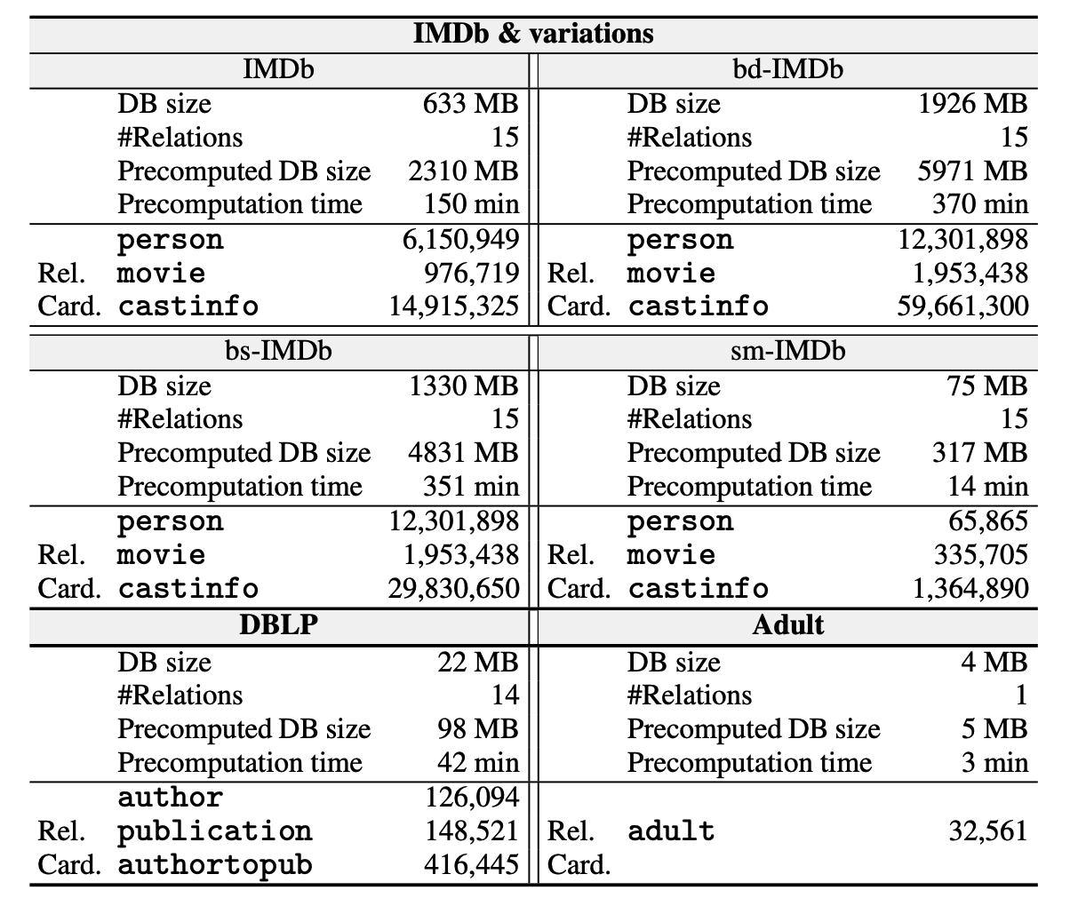
Offline precomputation

Slide 38
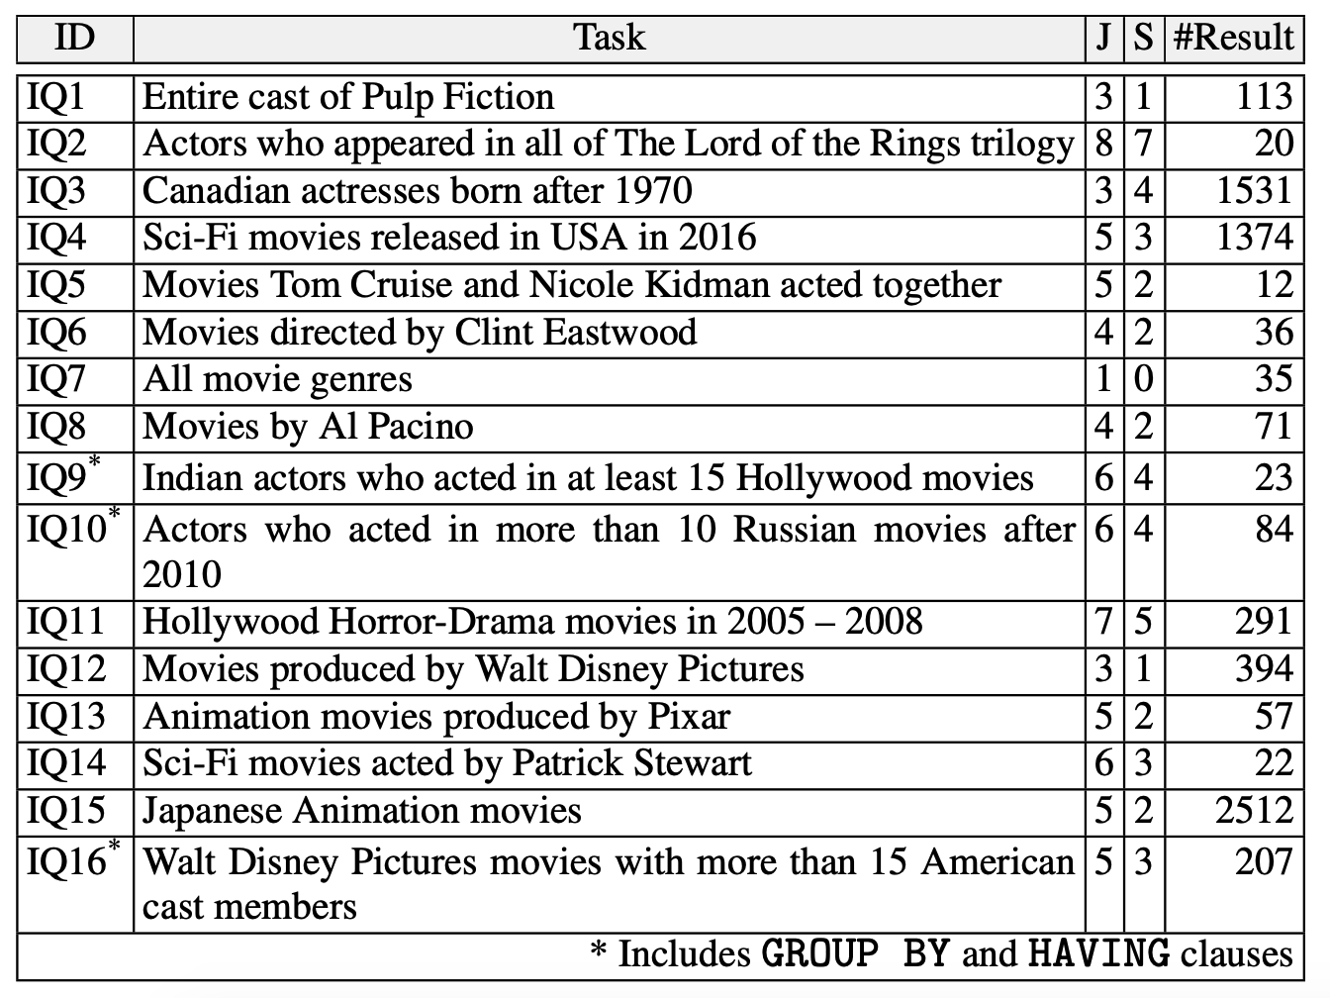
Benchmark queries

Slide 39
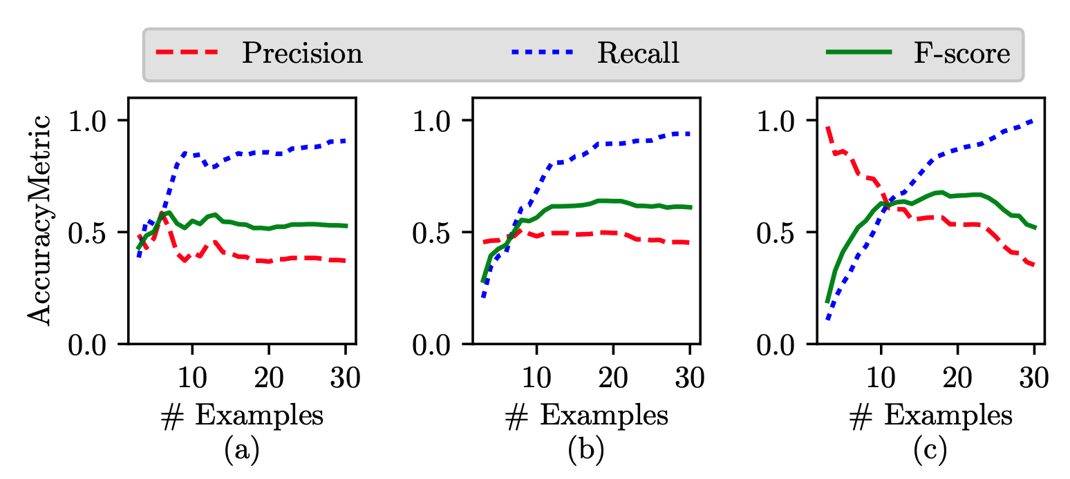
Case studies

Slide 40
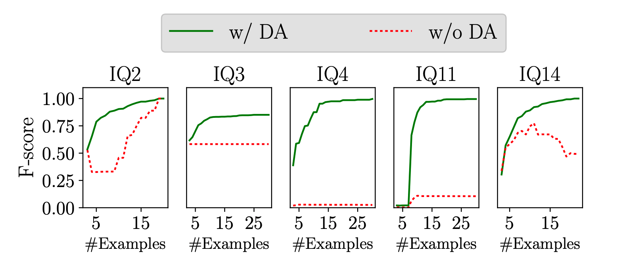
Disambiguation

Slide 41
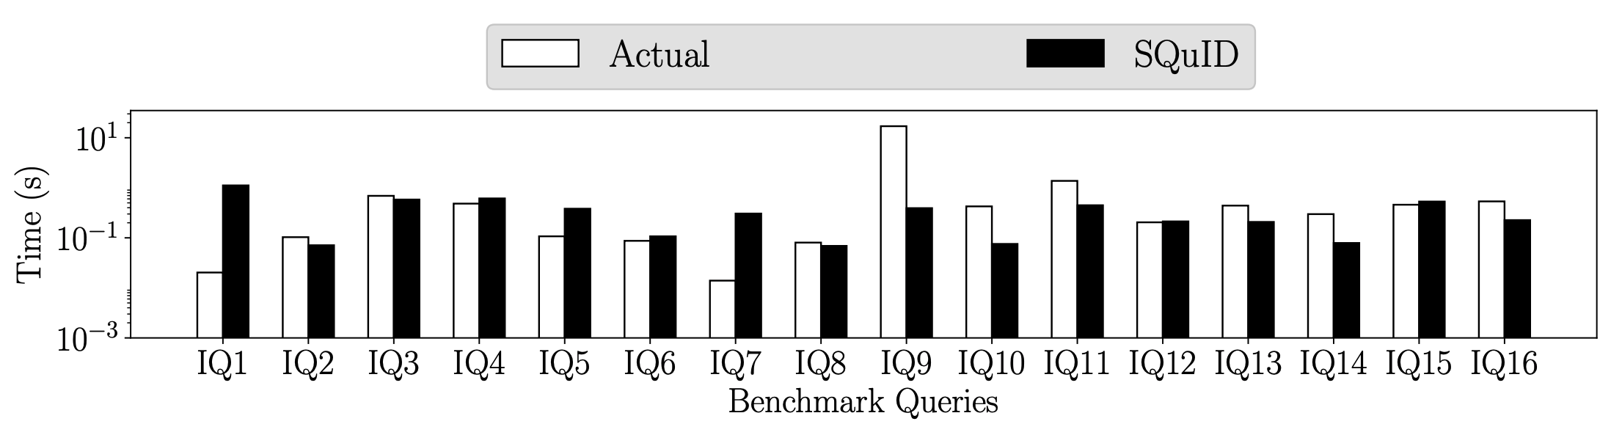
SQuID query vs actual query

Slide 42
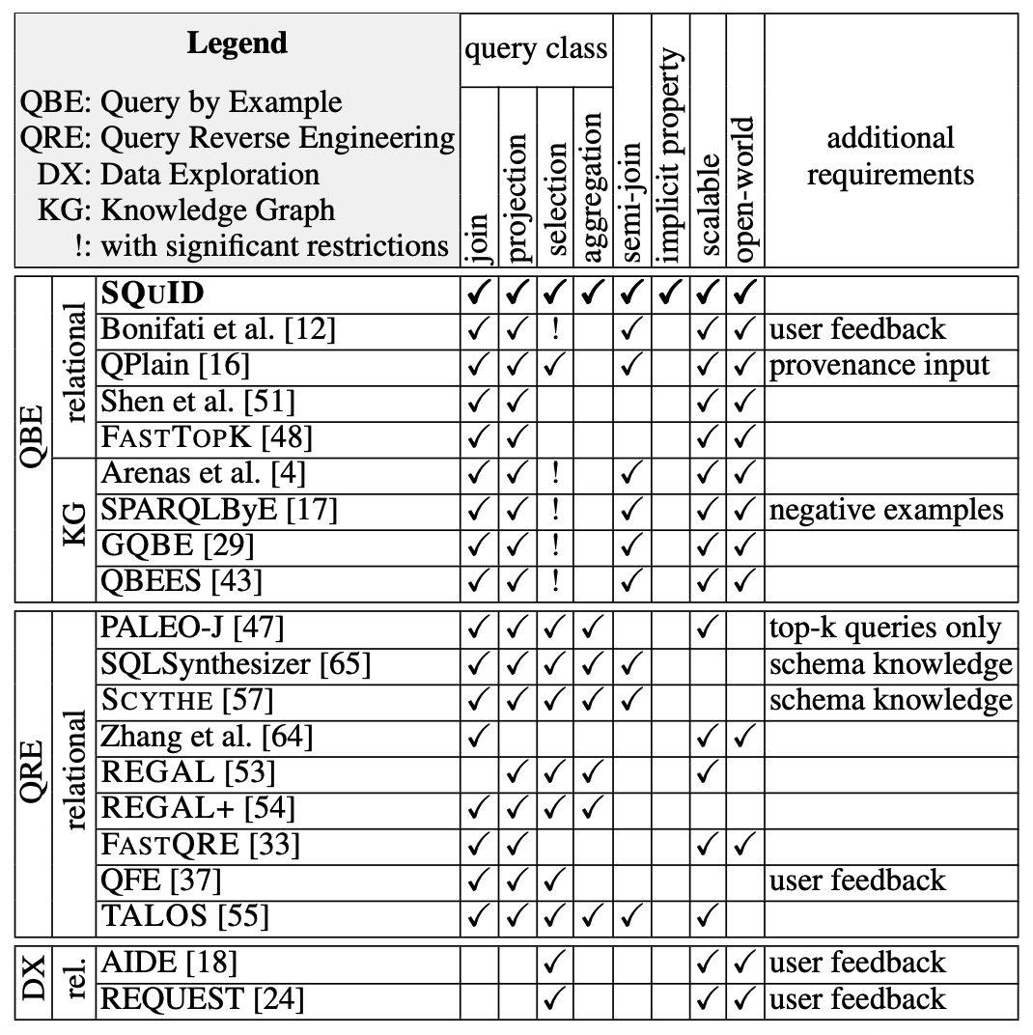
Related work

